Slide 1

Project-1

Slide 2

Project Reports
Notes:
actionButton
No alt text provided.
image
No alt text provided.
Data Visualization
No alt text provided.

Slide 3
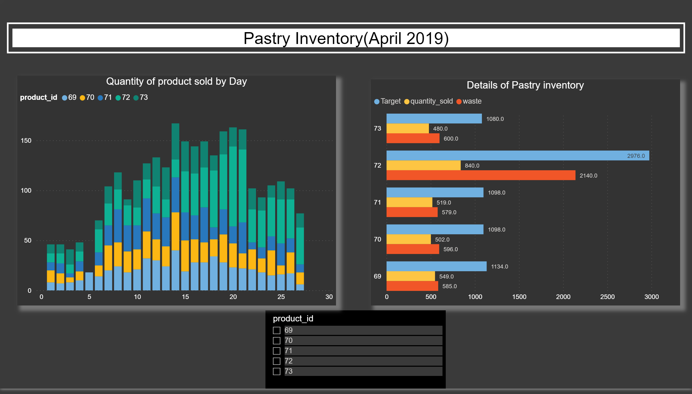
Report-1
Notes:
Details of Pastry inventory
No alt text provided.
slicer
No alt text provided.
Quantity of product sold by Day
No alt text provided.
Pastry Inventory(April 2019)
No alt text provided.
basicShape
No alt text provided.

Slide 4
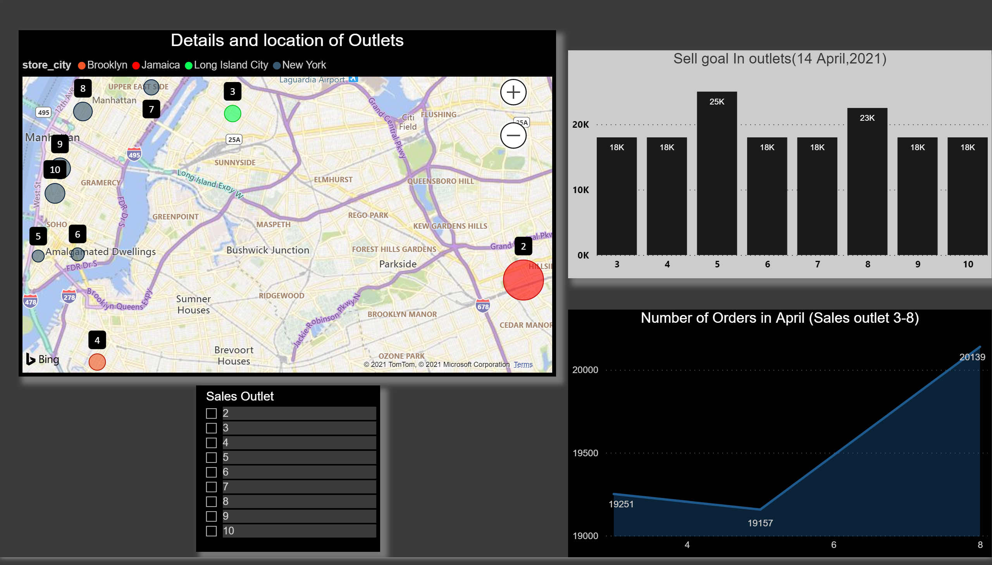
Report-2
Notes:
Sell goal In outlets(14 April,2021)
No alt text provided.
Details and location of Outlets
No alt text provided.
Number of Orders in April (Sales outlet 3-8)
No alt text provided.
slicer
No alt text provided.

Slide 5
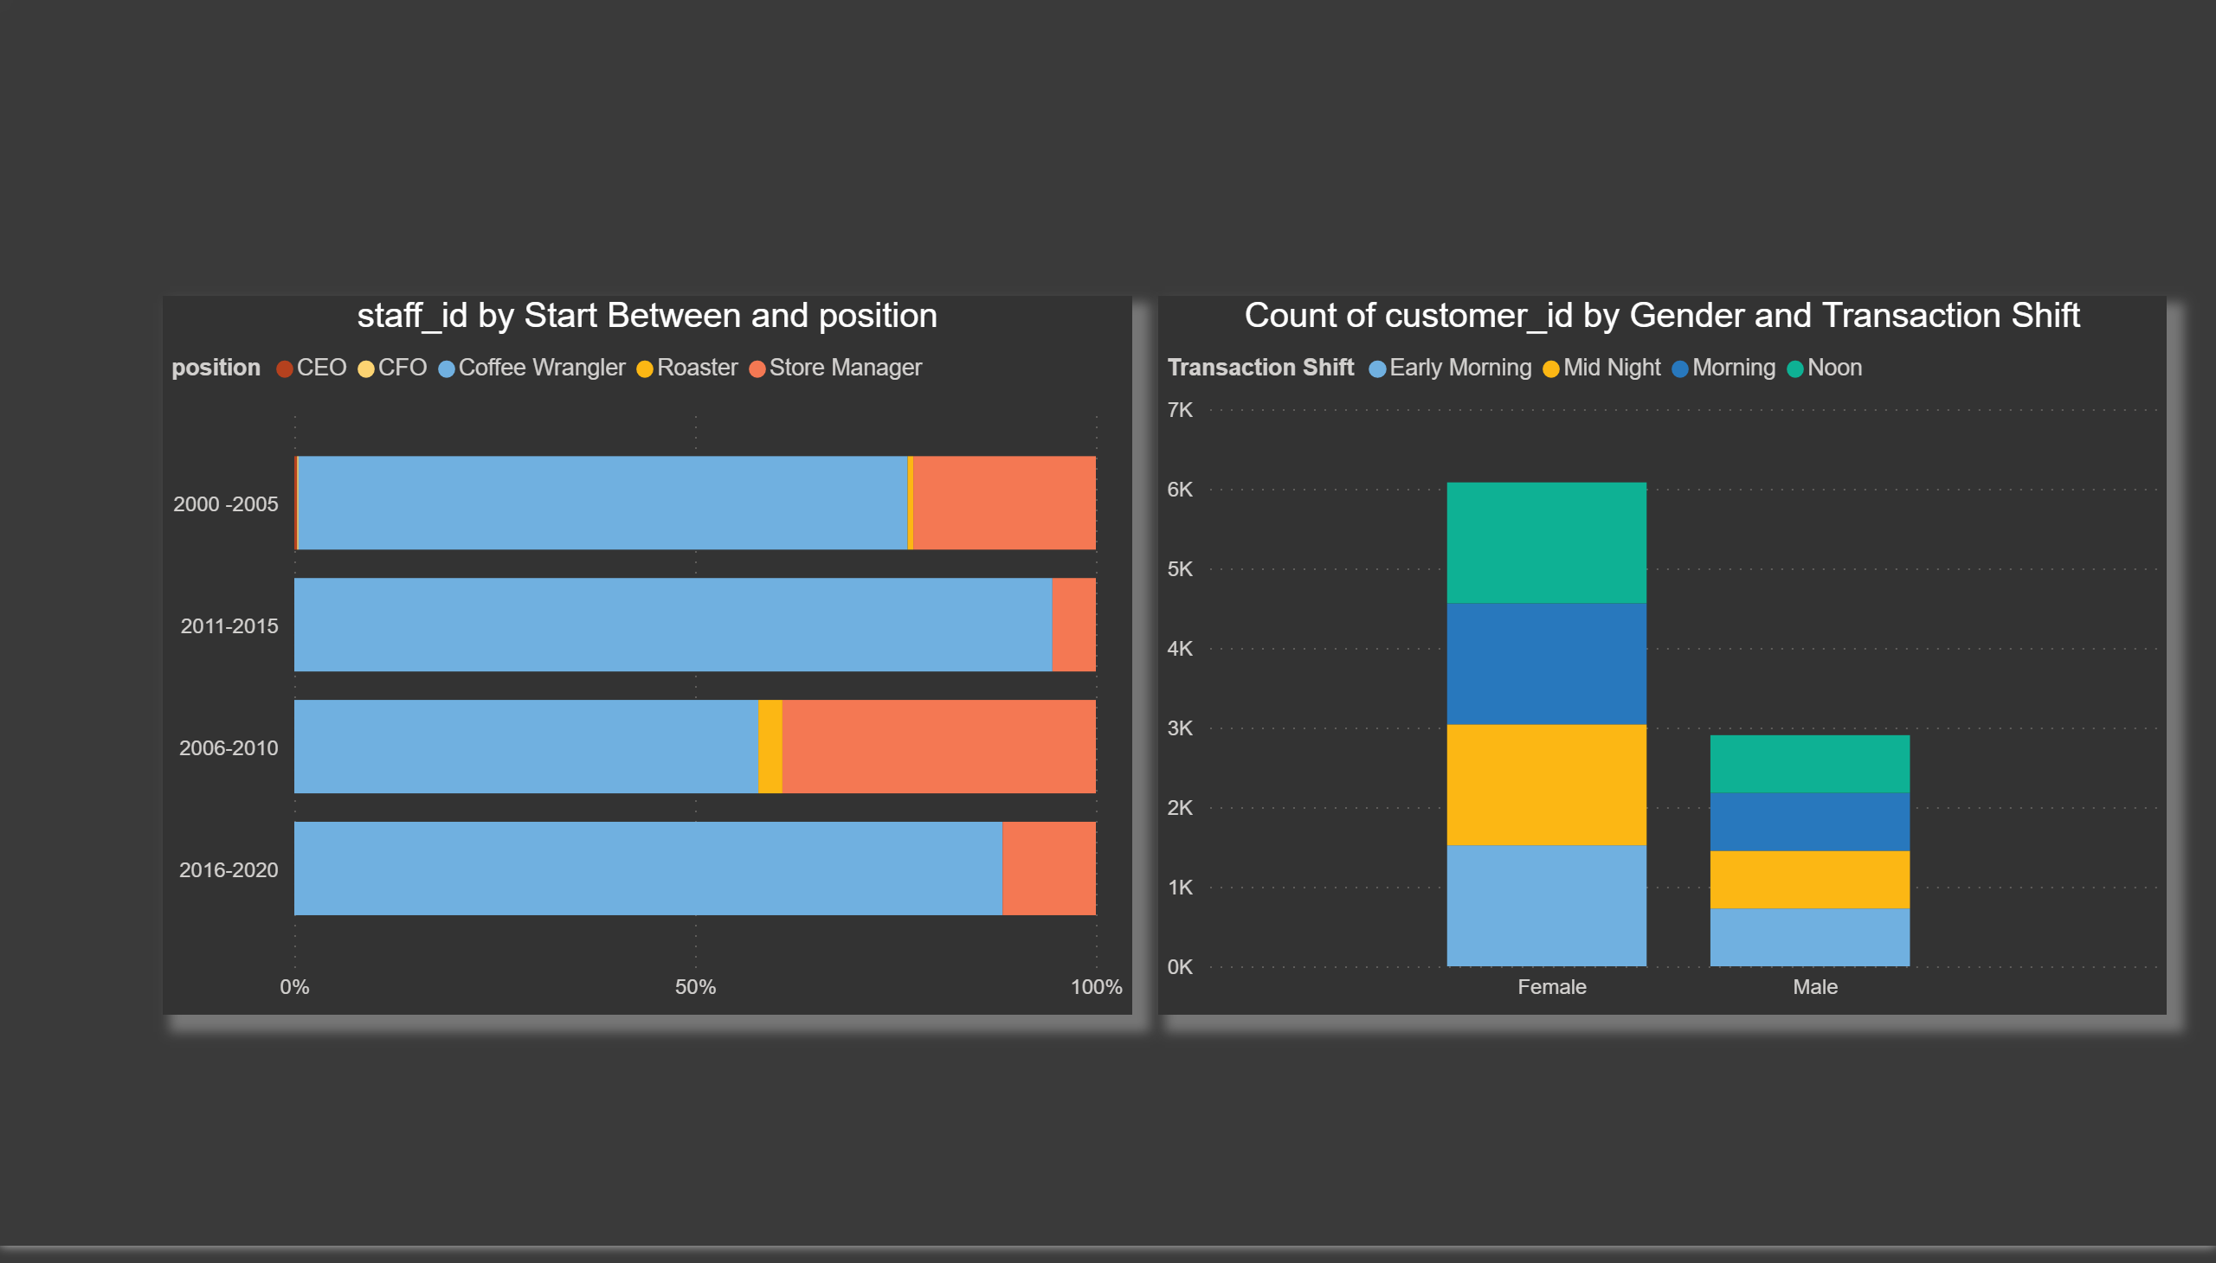
Report-3
Notes:
hundredPercentStackedBarChart
No alt text provided.
columnChart
No alt text provided.

Slide 6
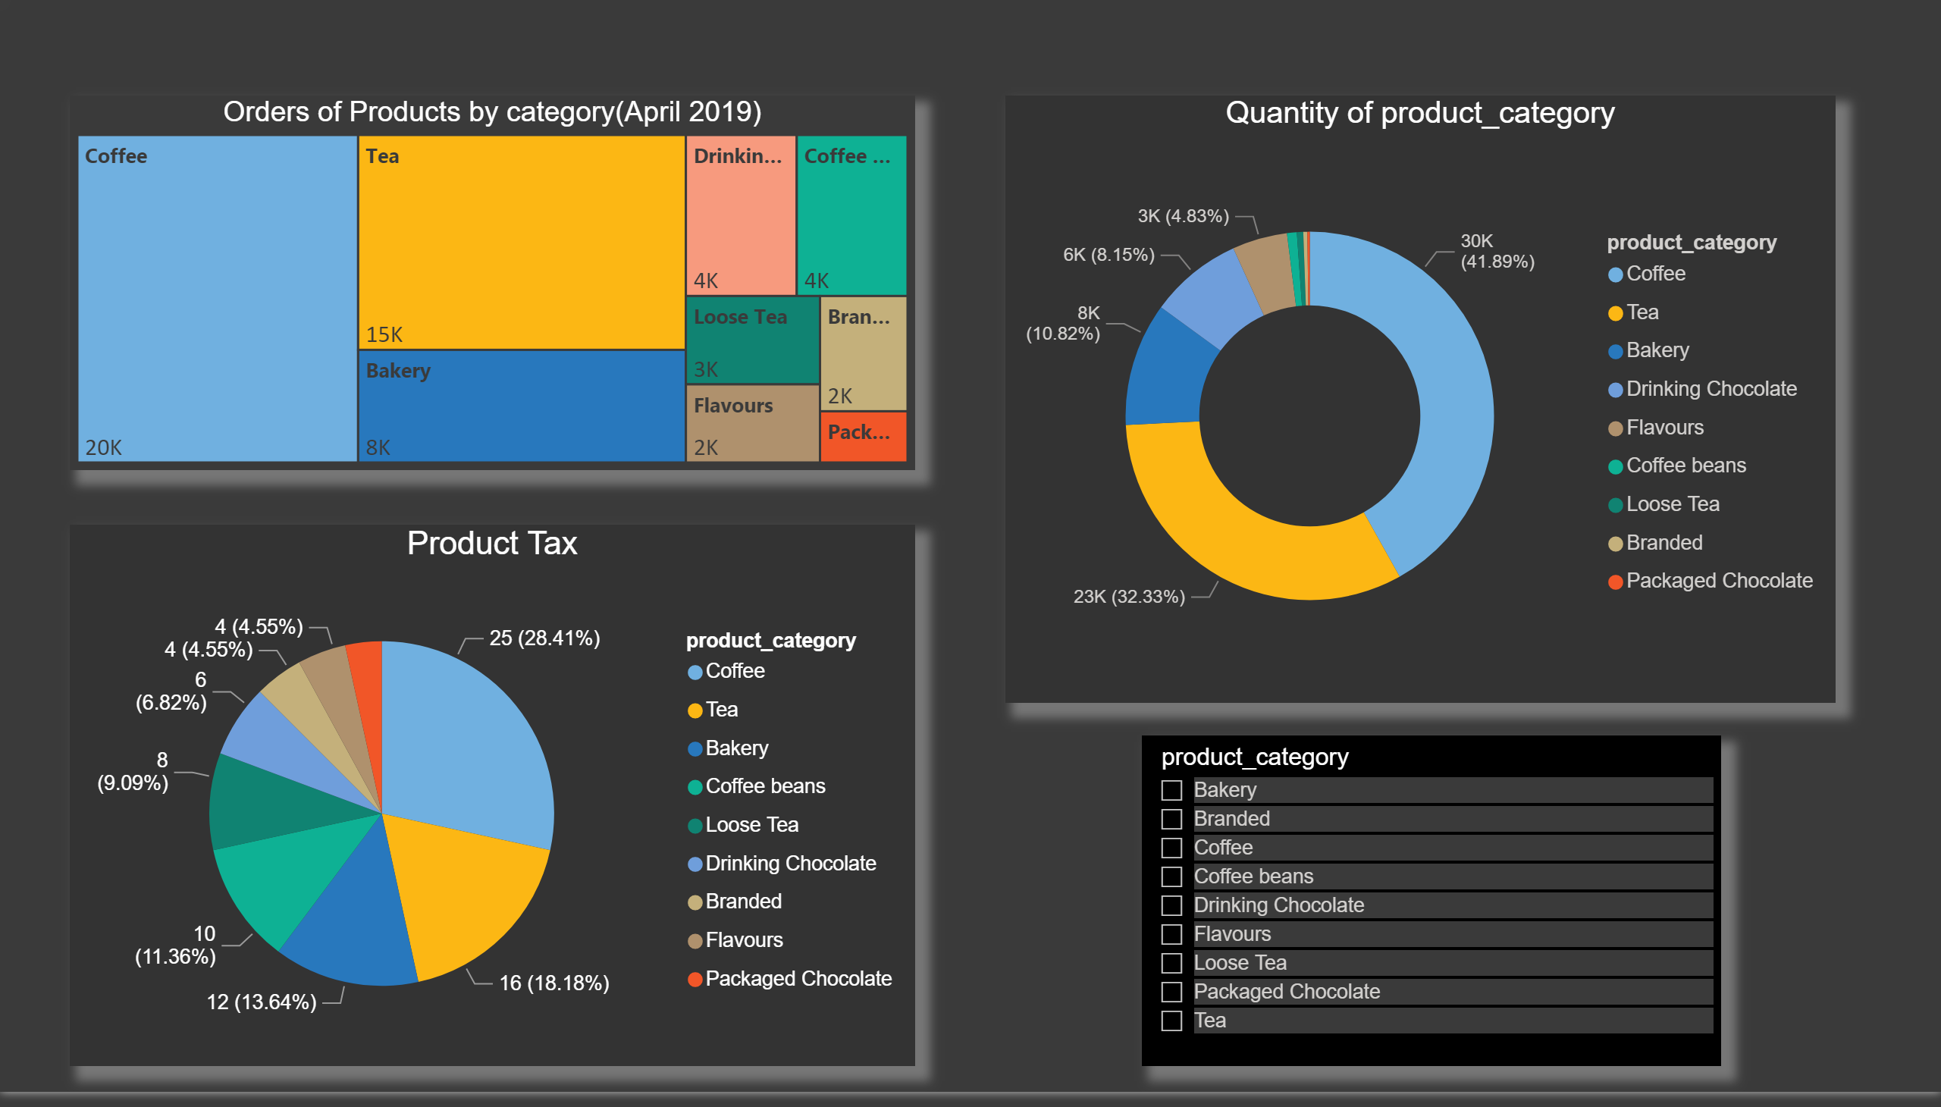
Report-4
Notes:
Orders of Products by category(April 2019)
No alt text provided.
Quantity of product_category
No alt text provided.
Product Tax
No alt text provided.
slicer
No alt text provided.

Slide 7
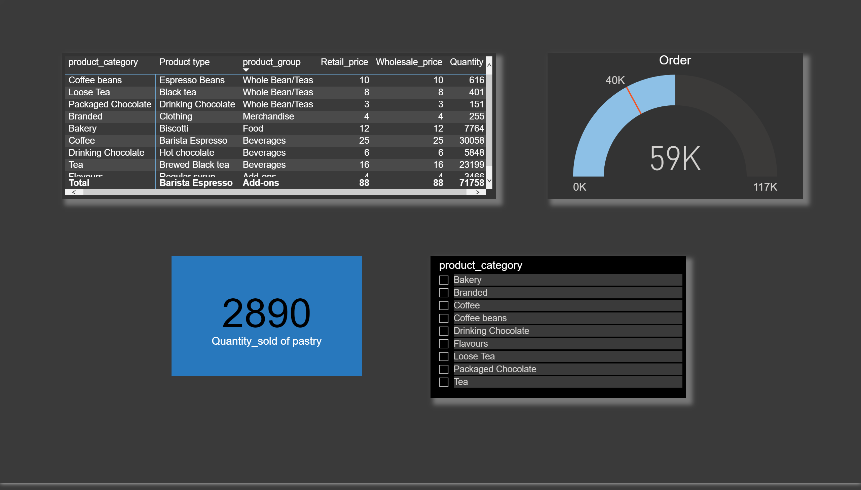
Report-5
Notes:
pivotTable
No alt text provided.
card
No alt text provided.
Order
No alt text provided.
slicer
No alt text provided.

Slide 8

The End
Notes:
image
No alt text provided.
Thanks For Watching
No alt text provided.

